Slide 1
Now I am going to show you
A Project on Hotel Booking management System
In this project I have tried to focus only on JSP and JSF
Mechanism. Here you will be able to find how to transfer
Data to another pages through JSP and JSF. To make this project I have used net Bean IDEA.

Slide 2
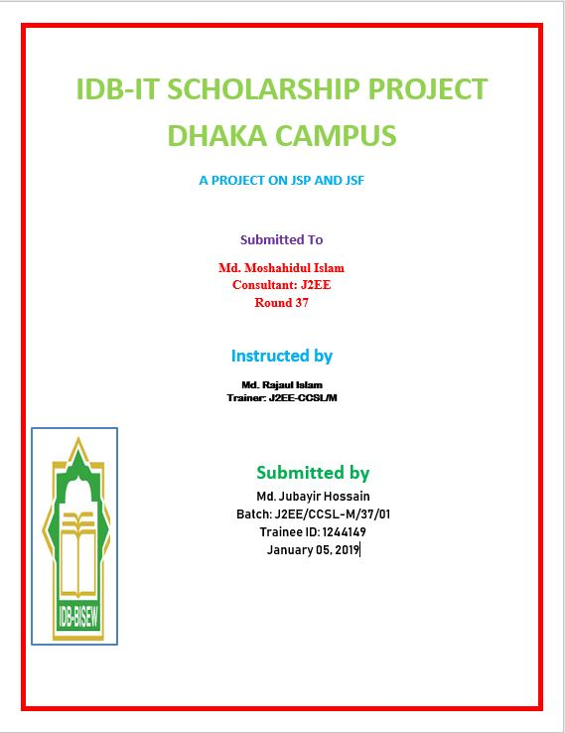

Slide 3
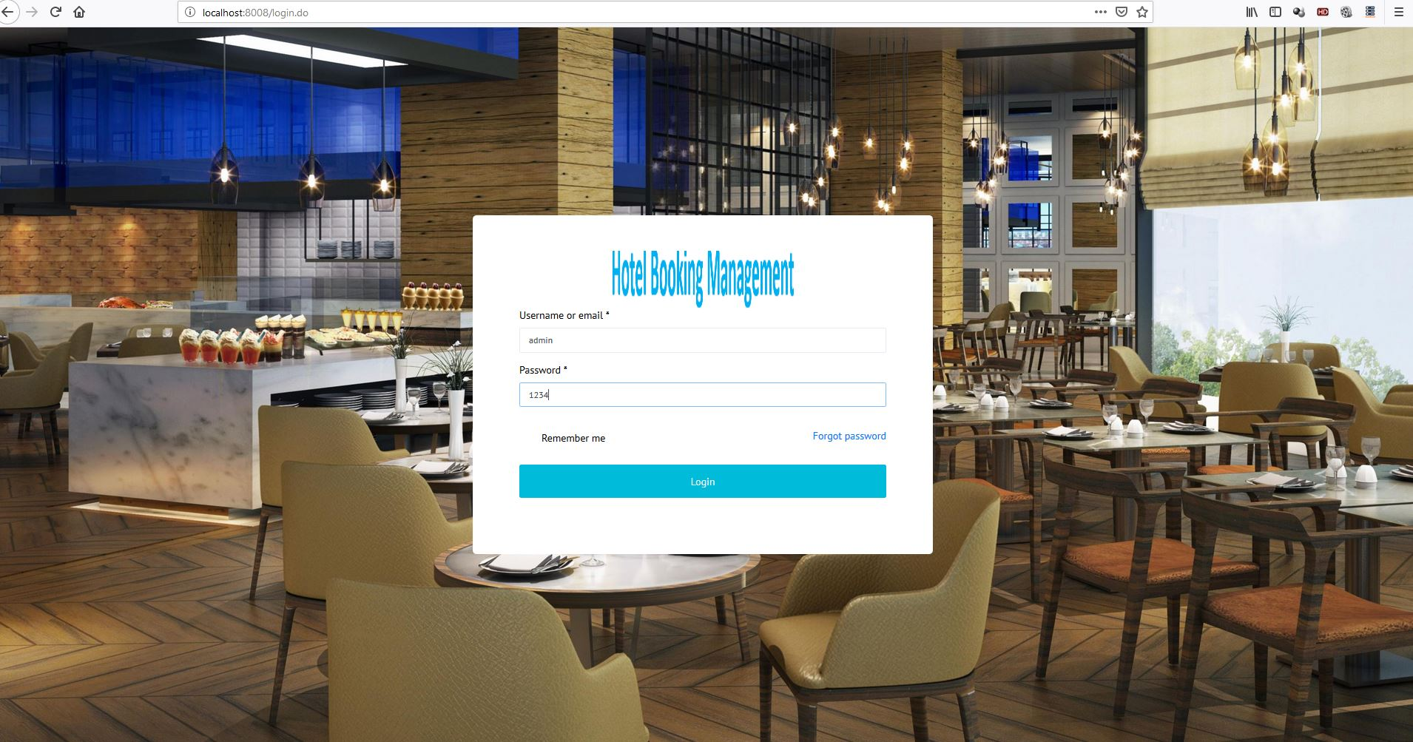
Login View

Slide 4
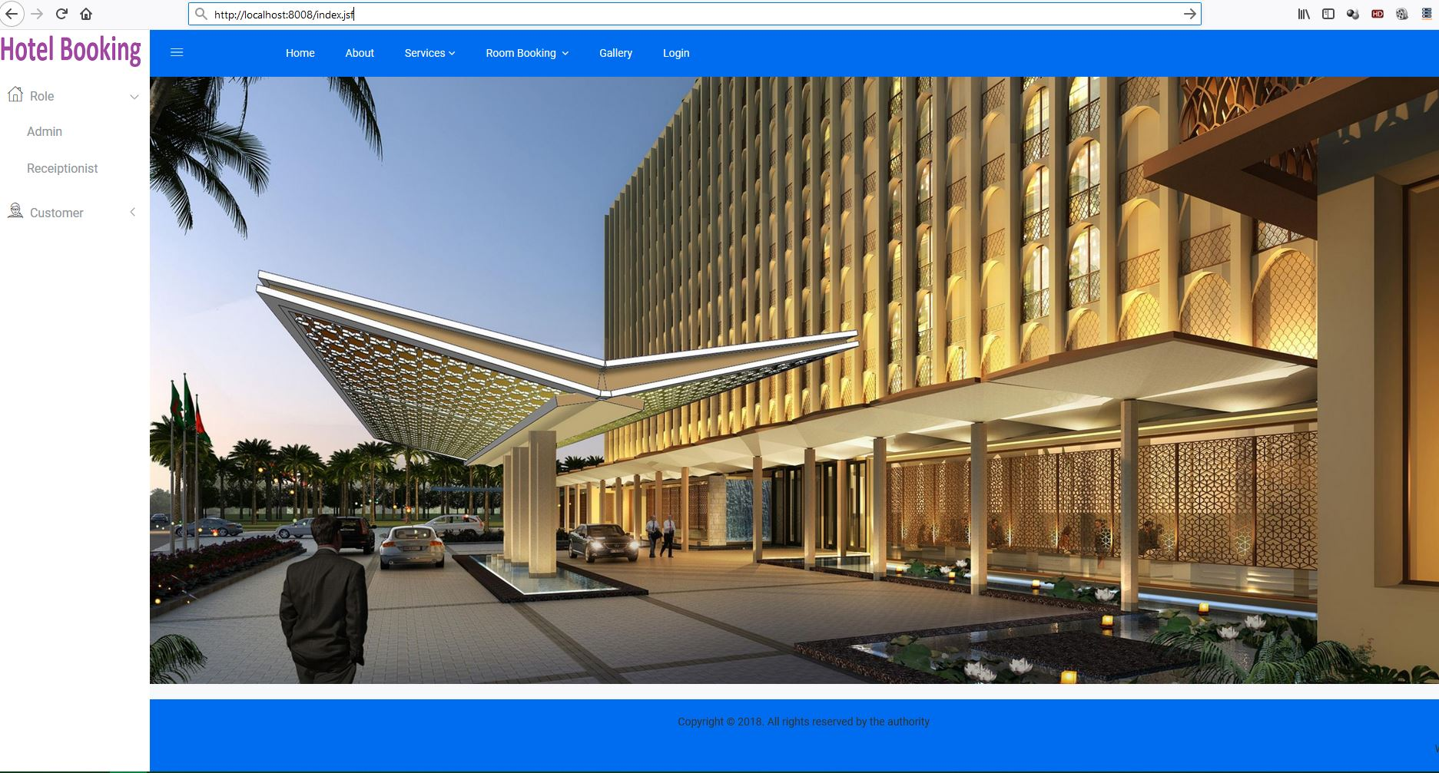
INDEX VIEW

Slide 5
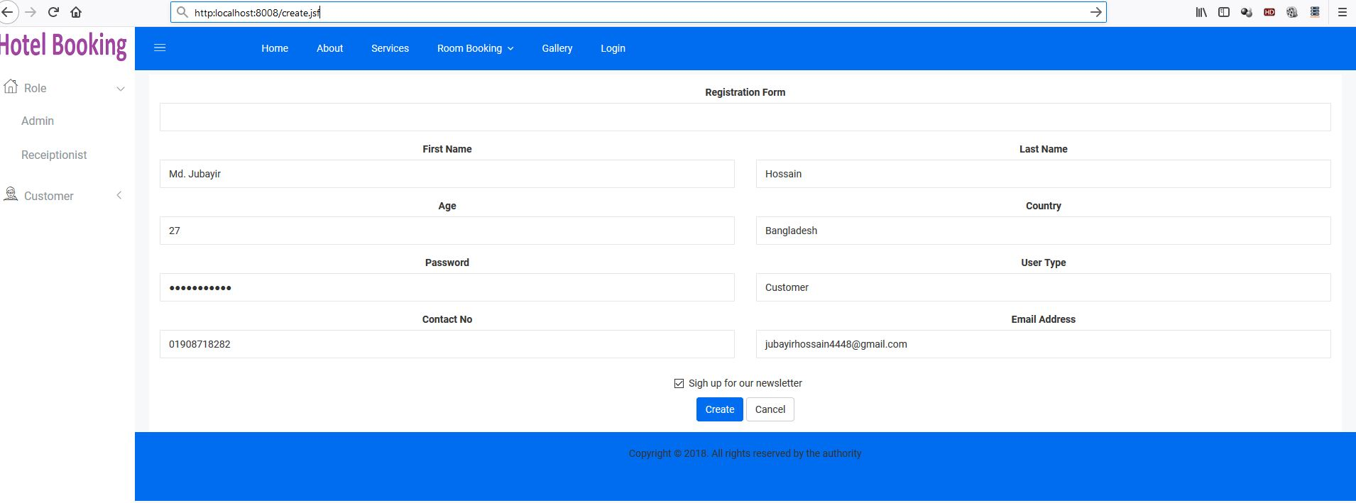
REGISTRATION FORM

Slide 6
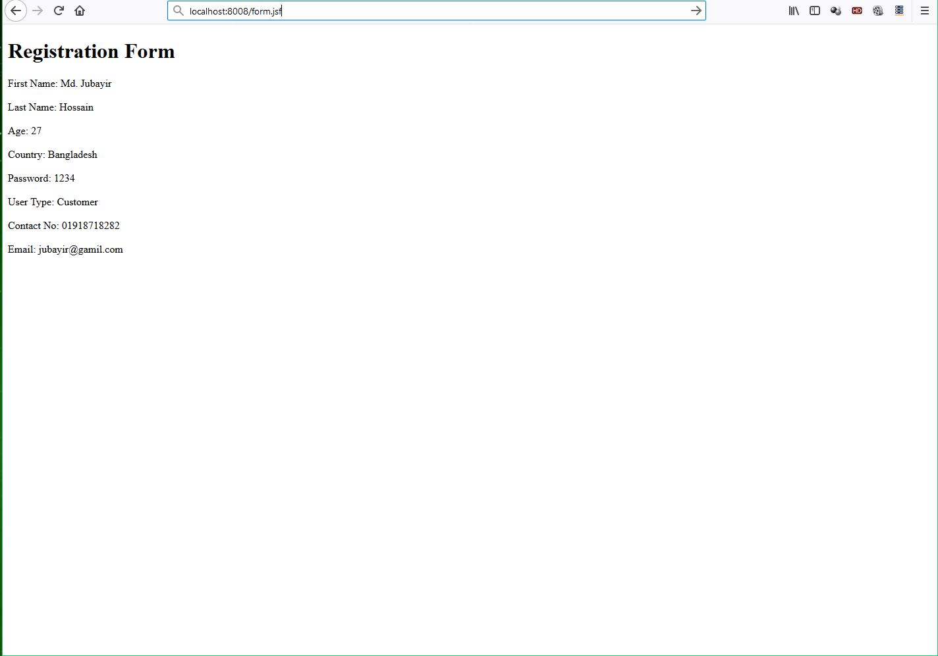
USER INPUT VIEW

Slide 7
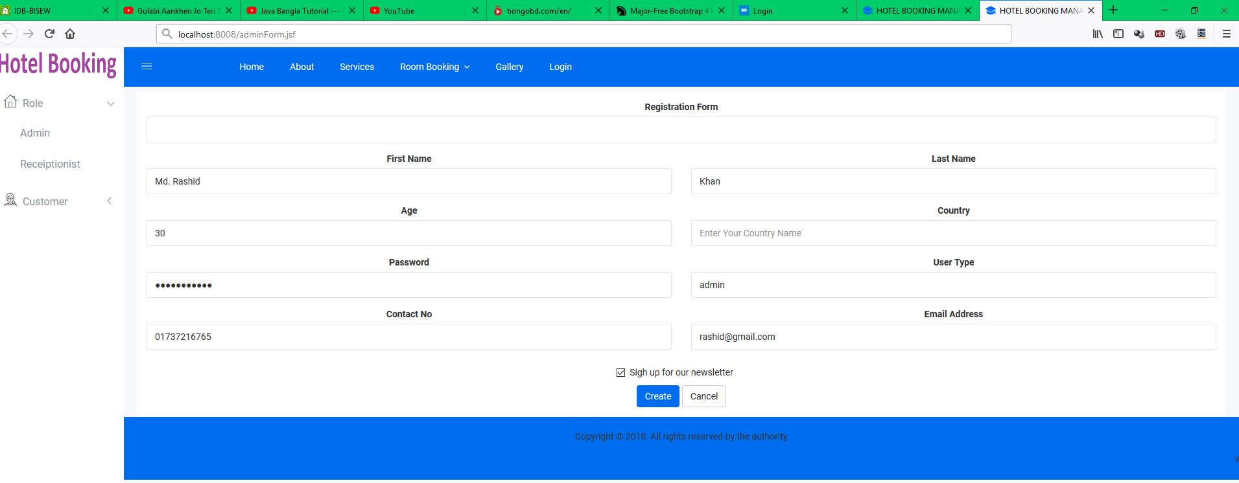
ADMIN FORM

Slide 8
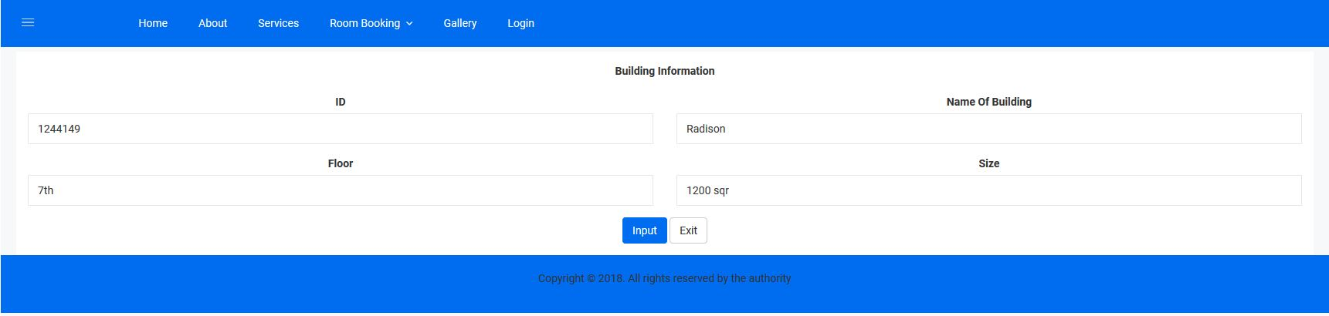
BUILDING TABLE

Slide 9
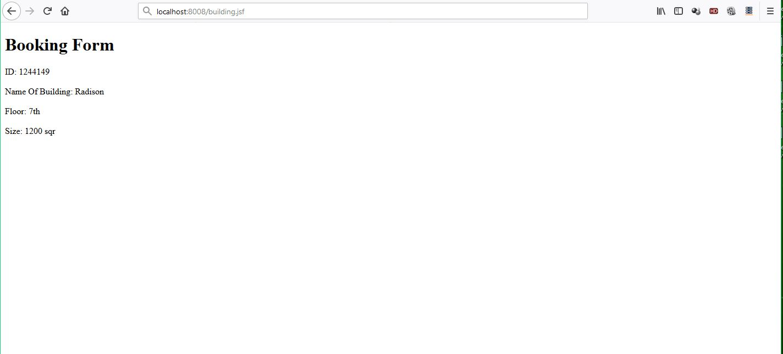
BOOKING FORM

Slide 10
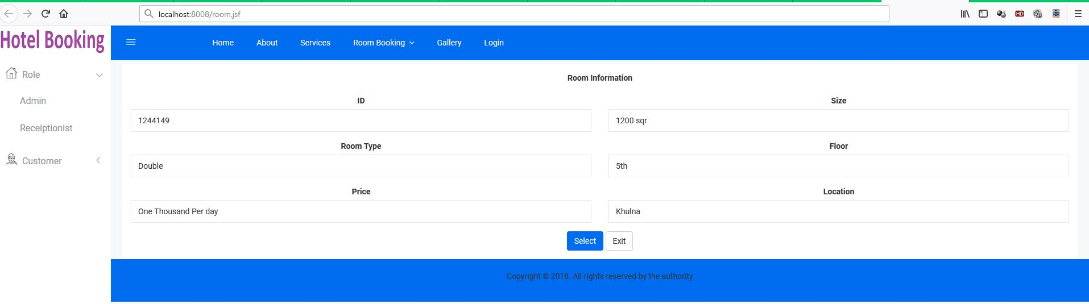
ROOM VIEW

Slide 11
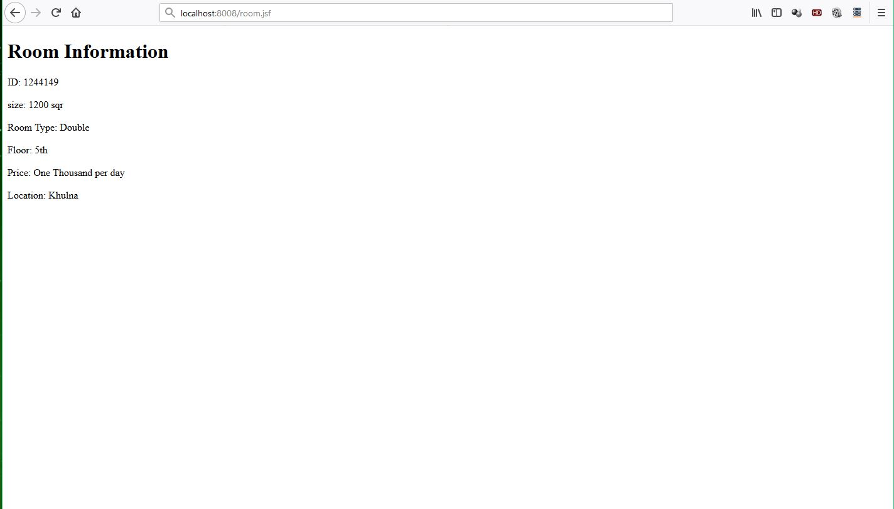
ROOM INFORMATION

Slide 12
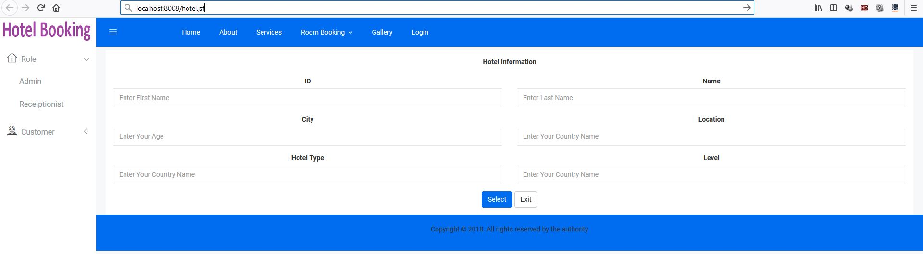
HOTEL VIEW

Slide 13
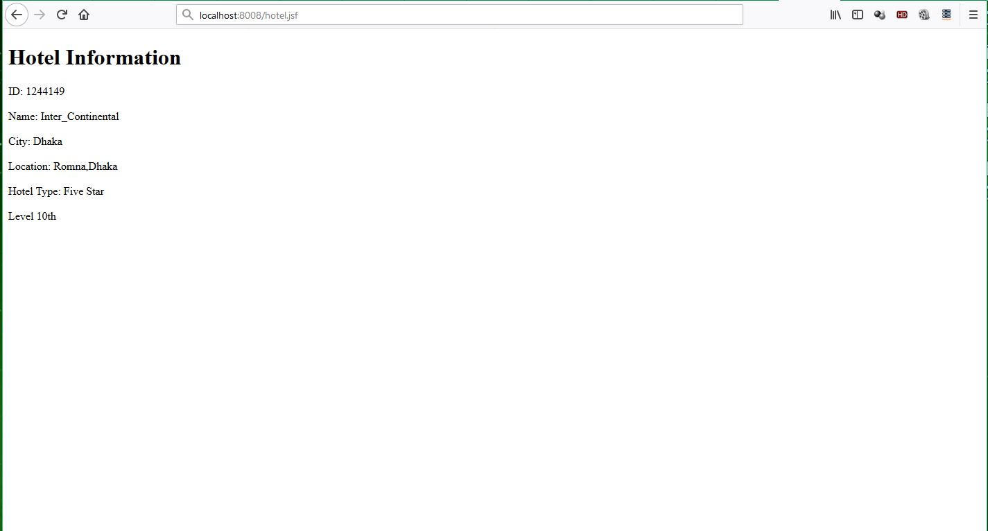
HOTEL INFORMATION

Slide 14
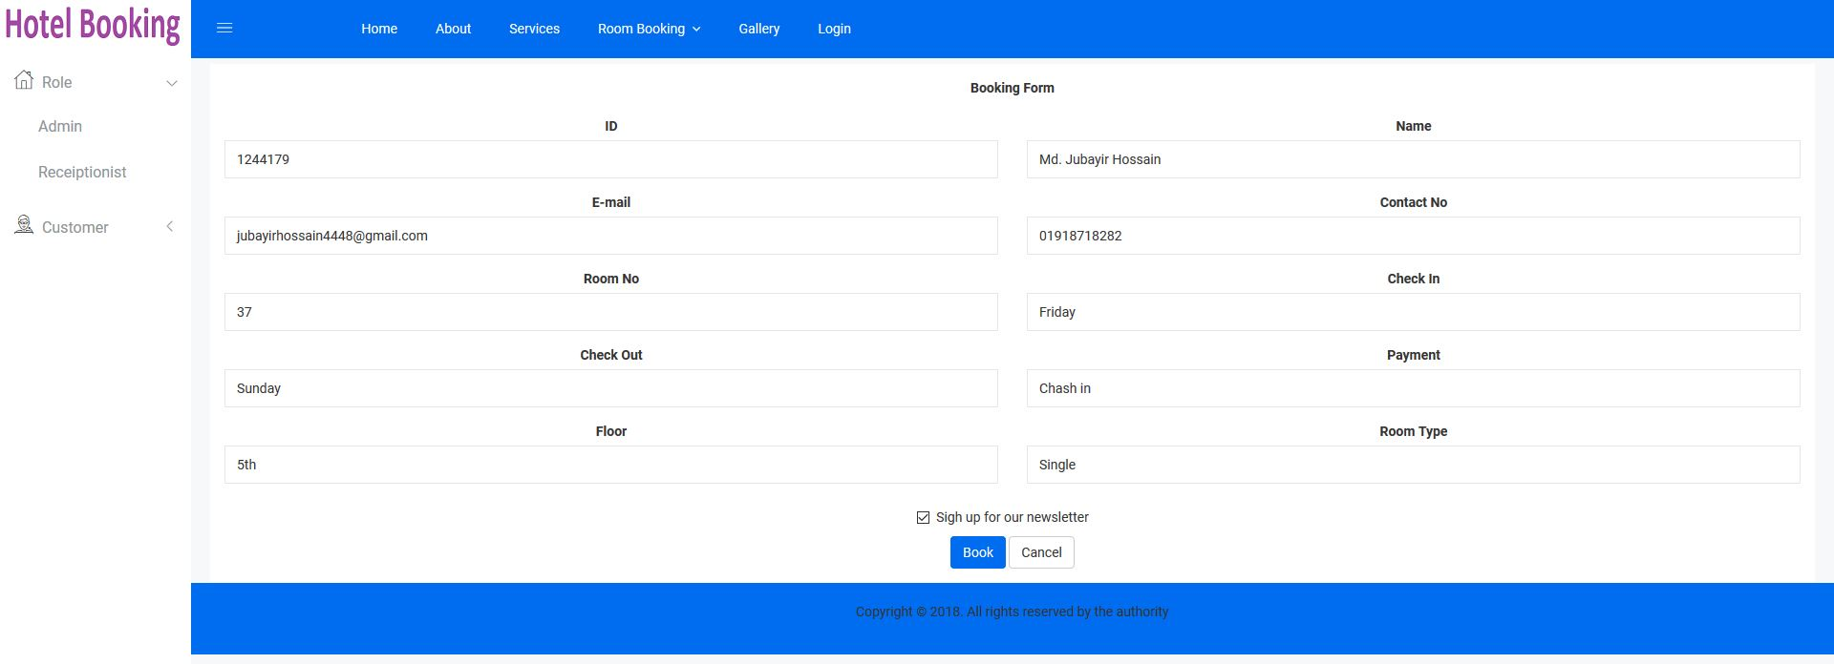
BOOKING VIEW

Slide 15
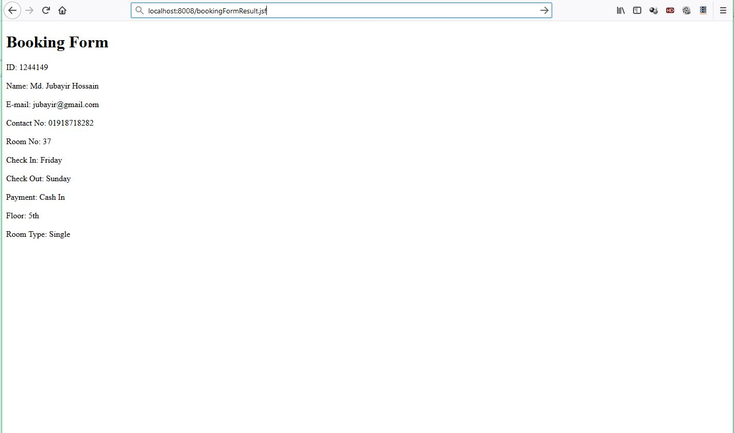
BOOKING FORM

Slide 16

SERVICE INFORMATION

Slide 17
Thank You Sir

